Slide 1
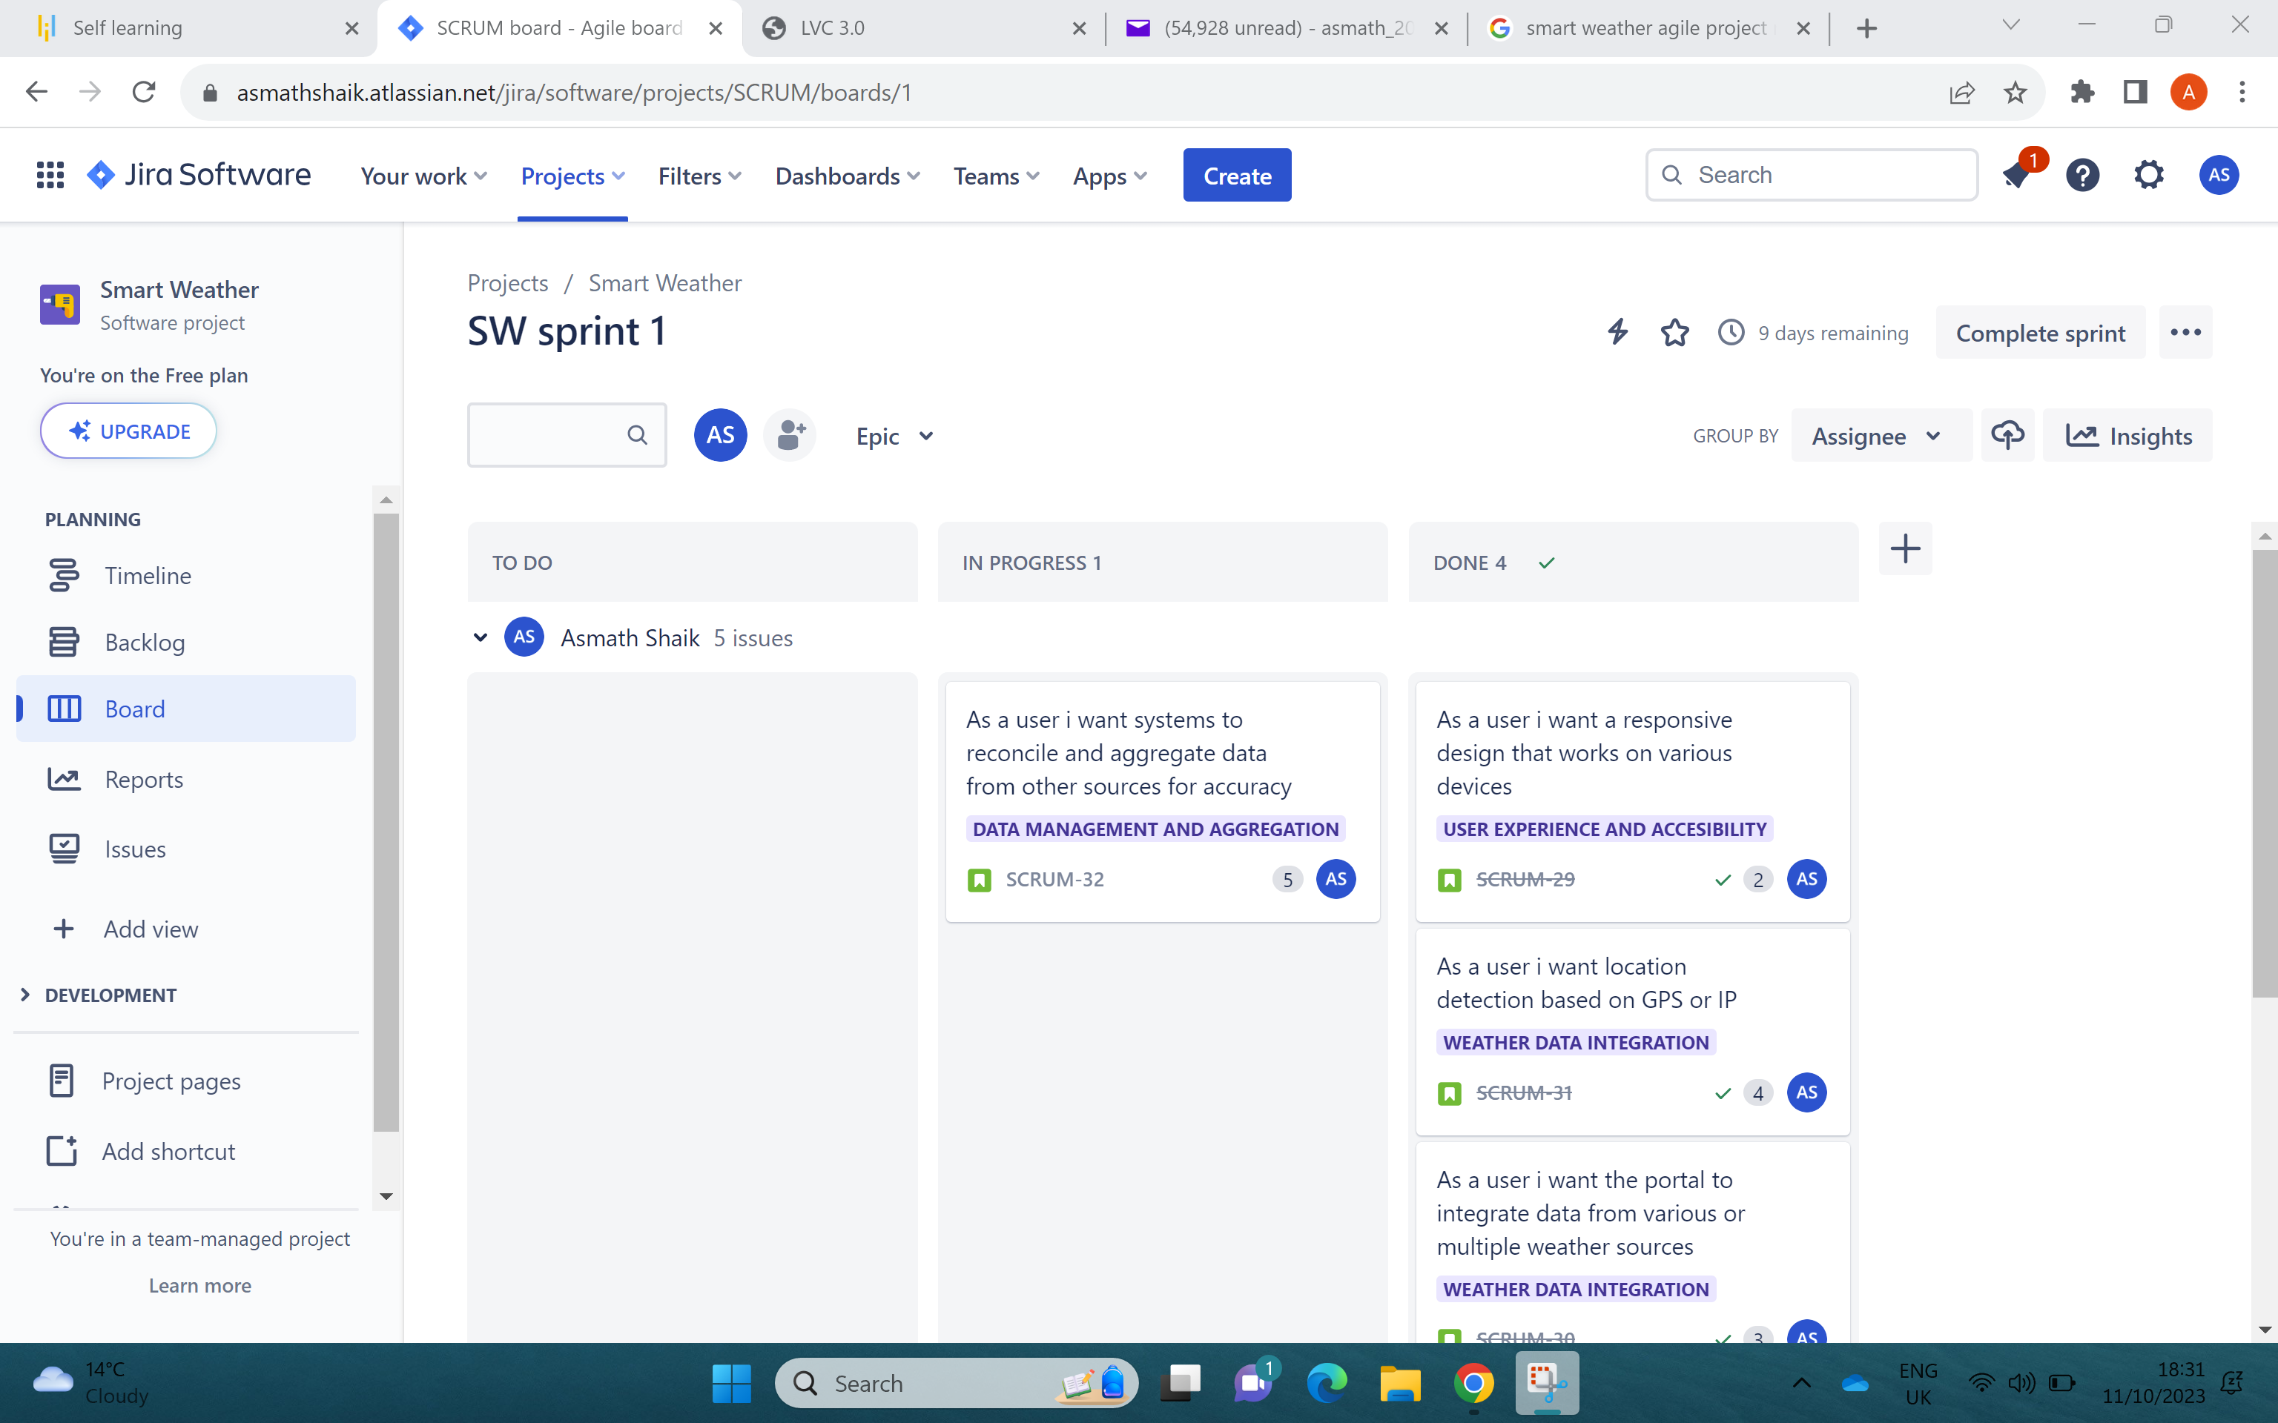
SPRINT WORK IN EXECUTION FIVE

Slide 2
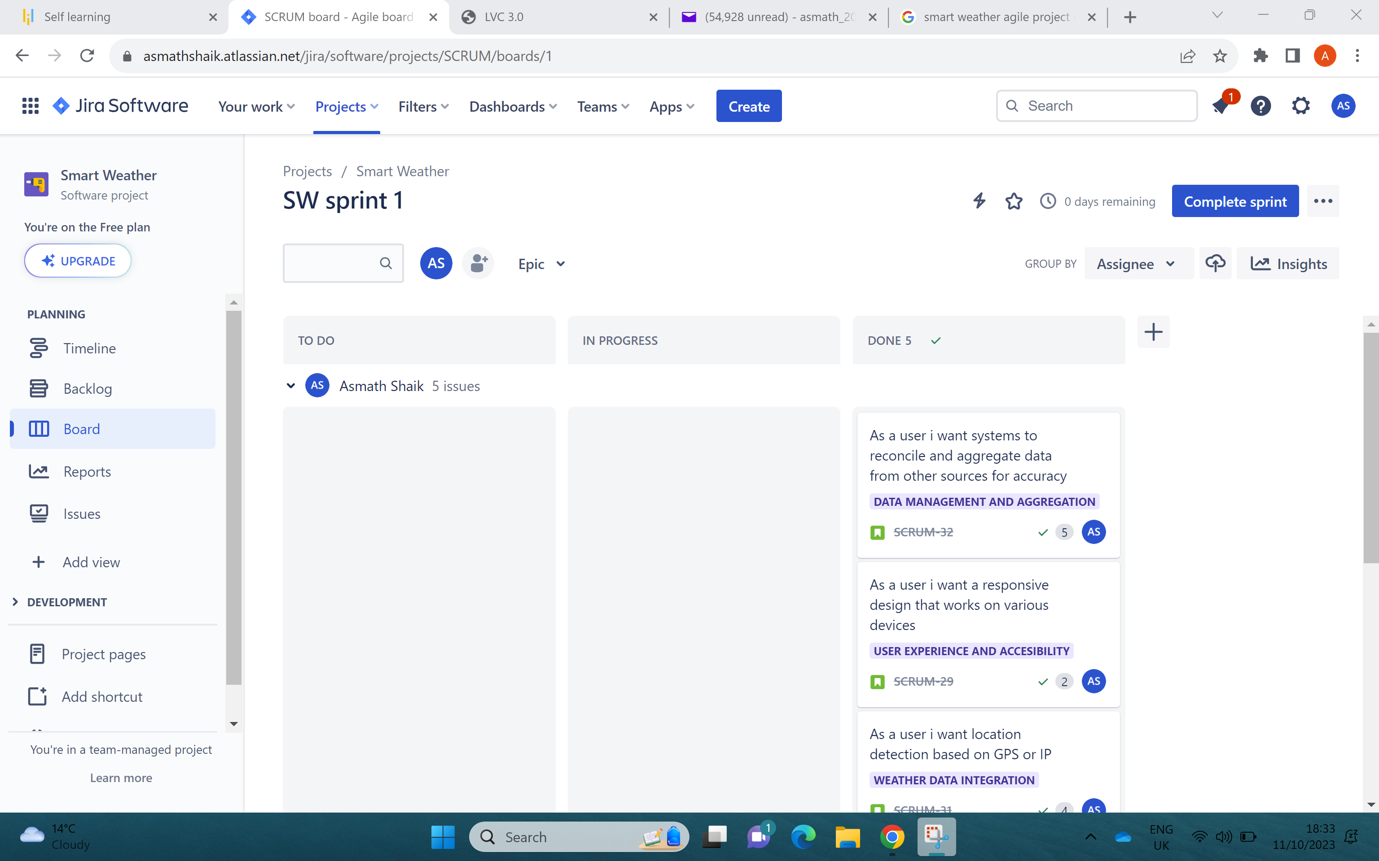
SPRINT WORK IN EXECUTION SIX

Slide 3
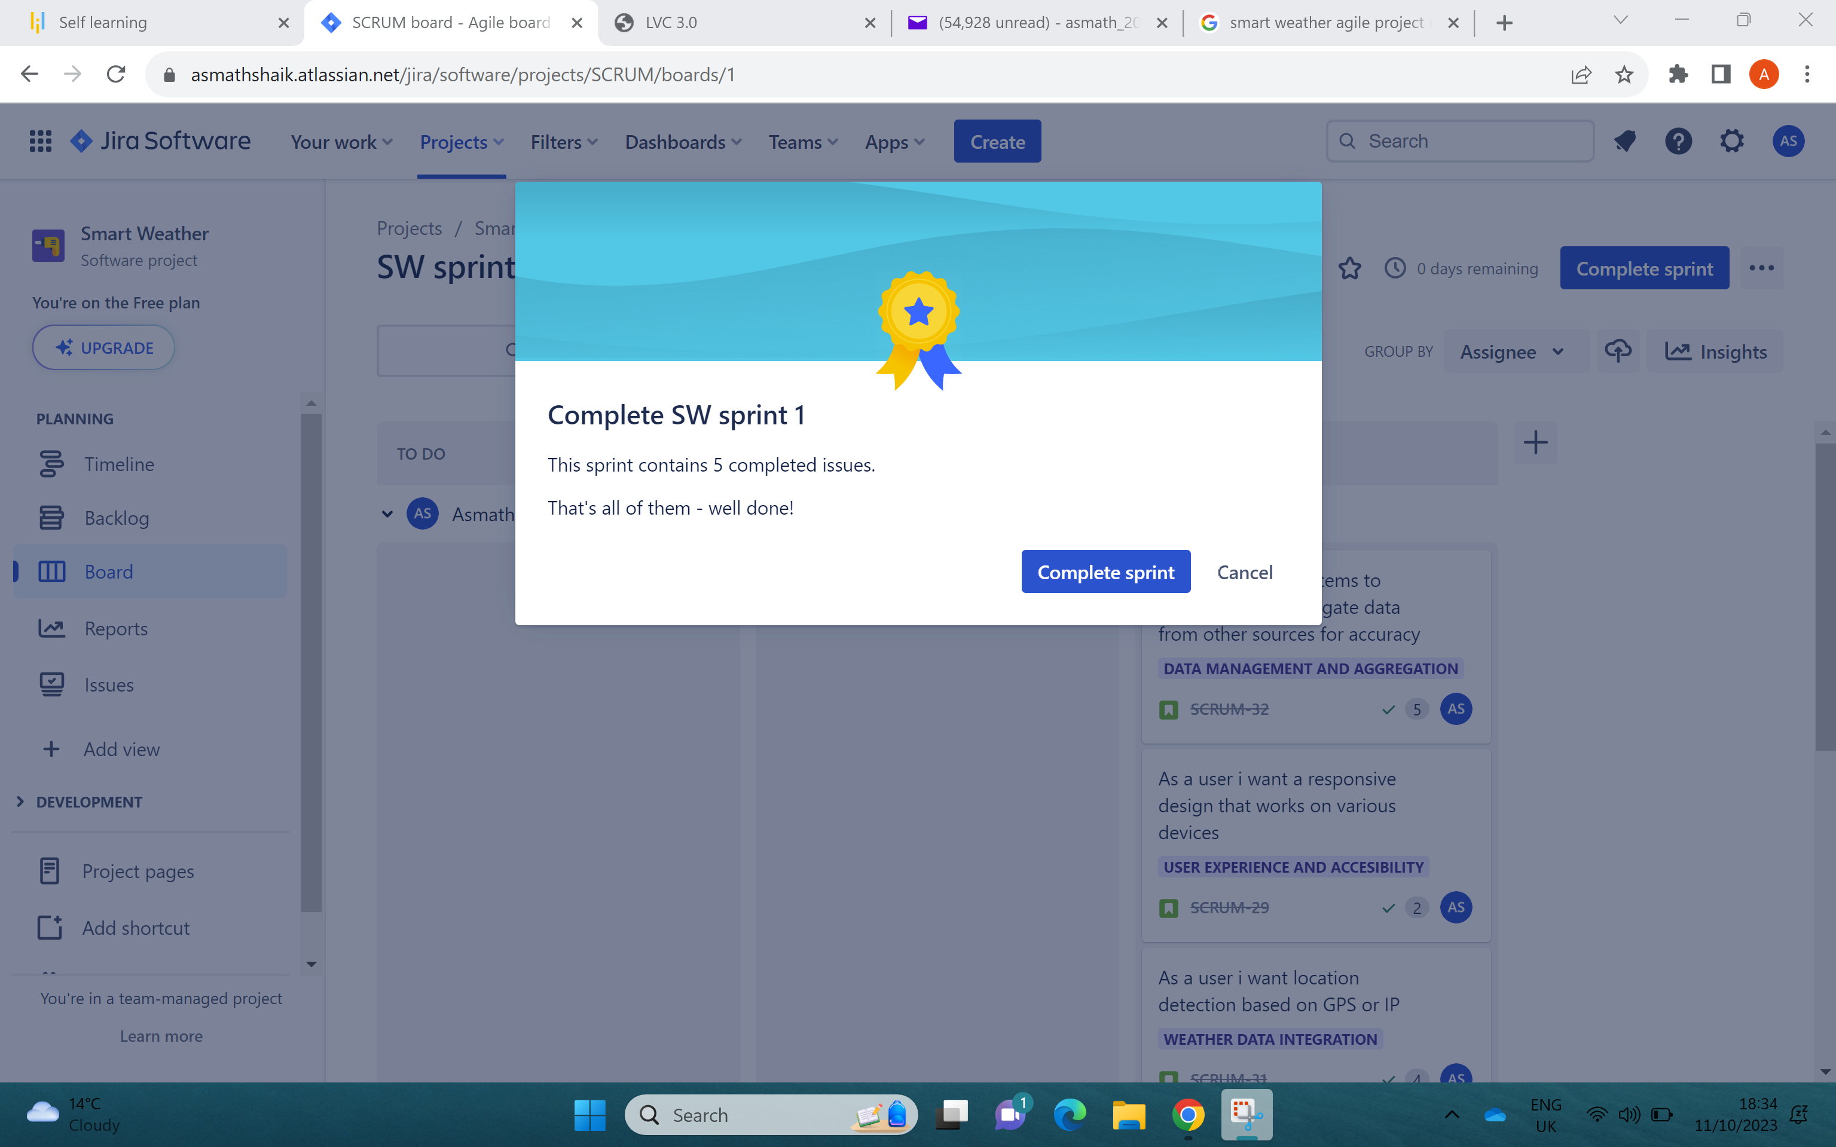
COMPLETED SPRINT 1

Slide 4
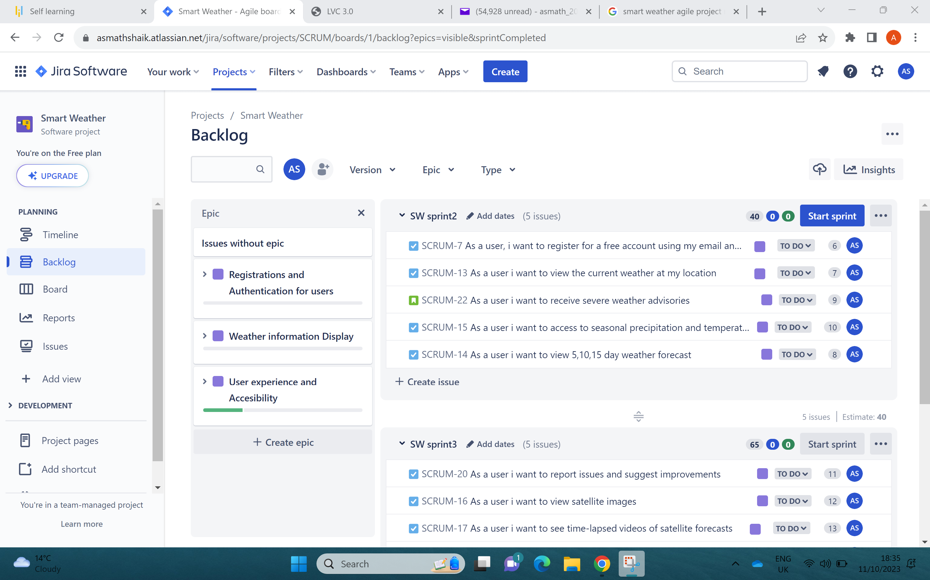
REMAINING SPRINTS IN BACKLOG

Slide 5
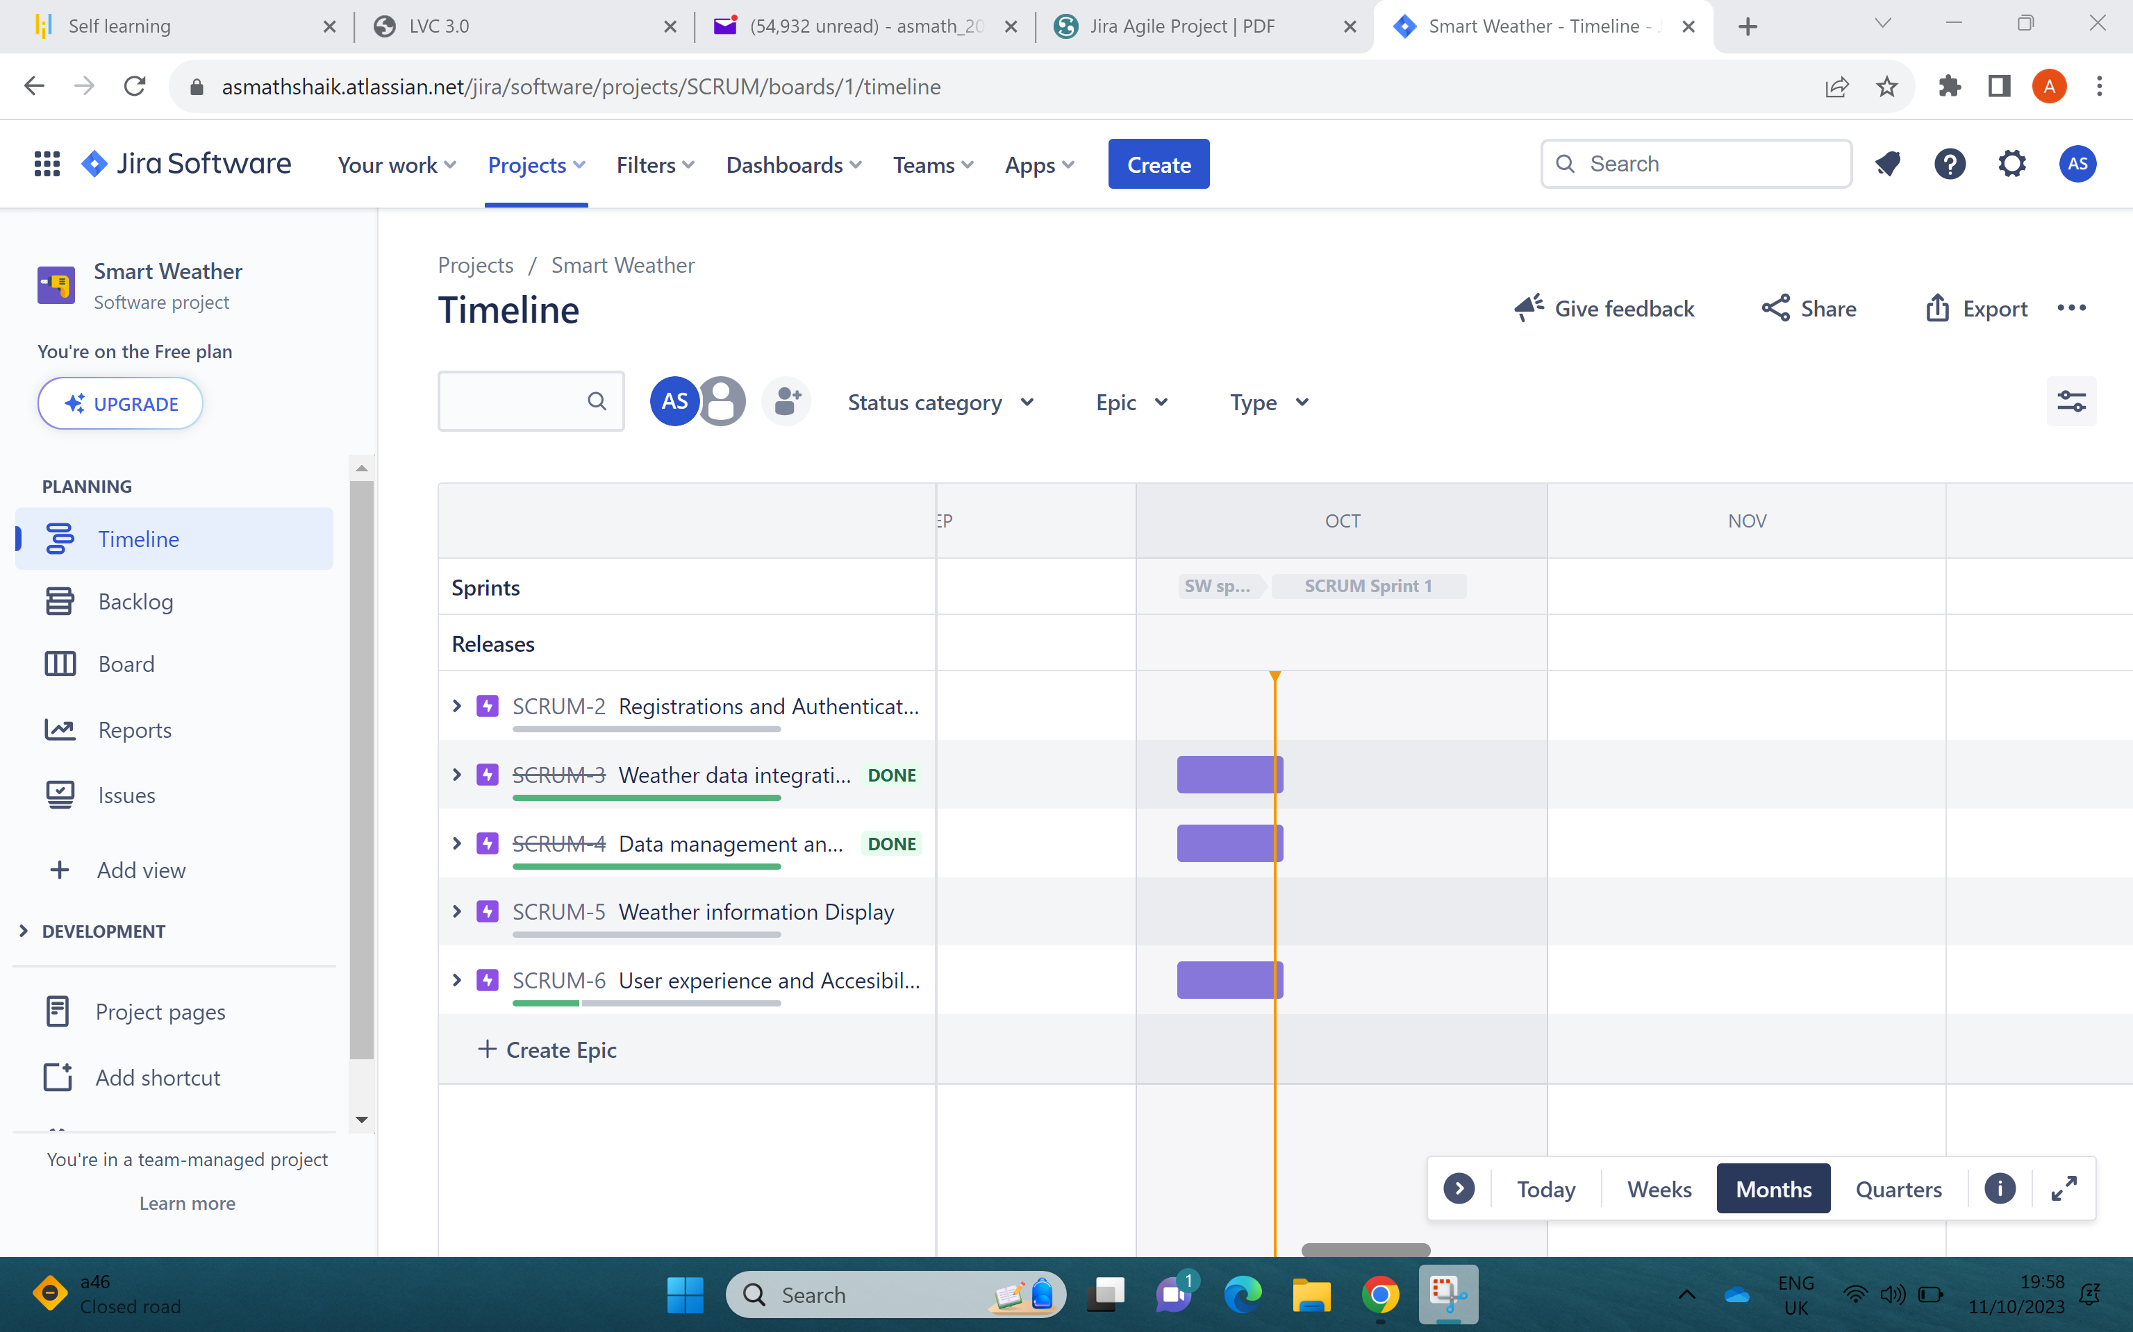
TIMELINE

